Slide 1
Analysis of Hospital Readmissions in Chronic Disease Patients
Asmita Samanta
Sakshi Patil

Slide 2
Background
High readmission rates from chronic diseases, notably diabetes.
Readmissions within 30 days frequent, affecting patient health and healthcare costs.
Focus on identifying high-risk patients for proactive interventions.
Analysis of demographics, clinical data, and hospital metrics to reduce readmissions.
Notes:
Due to poor healthcare quality, there are a lot of instances around the world especially in third world countries, where patients are admitted back to the hospital shortly after being discharged, typically within 30 days, due to the same or related health issues. This is a critical situation especially for patients with chronic diseases like diabetes. High readmission rates not only affect patients but also increase healthcare costs. The business problem is to identify patients at high risk of readmission, allowing healthcare providers to implement proactive interventions.

Slide 3
Dataset
Diabetes Patient Data (Kaggle)
https://www.kaggle.com/datasets/brandao/diabetes
Notes:
The data set represents 10 years (1999-2008) of clinical care at 130 US hospitals and integrated delivery networks. It includes over 50 features representing patient and hospital outcomes. The data contains such attributes as patient number, race, gender, age, admission type, time in hospital, medical specialty of admitting physician, number of lab test performed, HbA1c test result, diagnosis, number of medication, diabetic medications, number of outpatient, inpatient, and emergency visits in the year before the hospitalization, etc.

Slide 4
Dataset Cleaning
Removed irrelevant columns with missing values
Categorized remaining 47 columns into 4 distinct categories
Ensured data types matched content
Adjusted column naming for consistency and clarity.
Notes:
Weight, Payer Code, and Medical specialty.
Patient Demographics, Clinical Variables, Medication Details, Hospitalization History, and Hospital Quality Metrics.
(e.g., integers for numerical columns).
Standardized categorical variables, replacing “?” with blanks and correcting formatting issues (e.g., “AfricanAmerican” to “African American”).

Slide 5
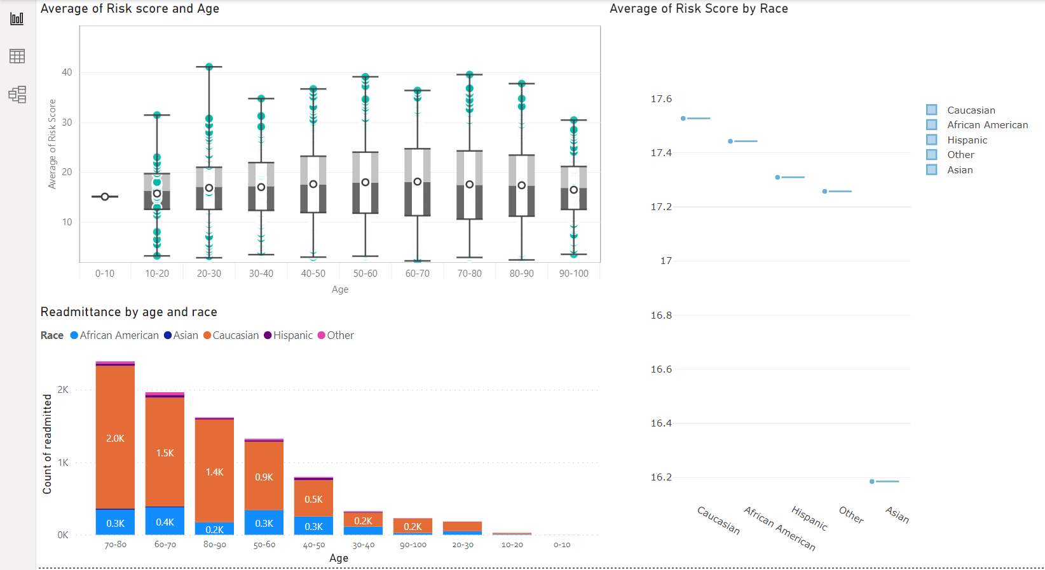
Highest Risk of Hospital Readmission among Diabetes Patients
Notes:
Who is at the highest risk of hospital readmission among diabetes patients? - readmittance (<30) and diabetic patient
Box plots display the distribution of readmission risk scores across different age groups.
Median risk scores and their interquartile ranges are depicted for each decade of age.
Format: A horizontal bar chart compares the average readmission risk scores among different racial groups.
The chart presents a simplified comparison, showing minimal variation in average risk scores between races.
A bar chart displaying the count of readmitted patients, segmented by age ranges and color-coded by race.
We have used risk score in our box plot and horizontal bar chart which is a calculated field . We created using [num_lab_procedures],[num_procedures],[number_diagnoses],[number_emergency],[number_inpatient], [number_outpatient],[time_in_hospital] and assigned them weights to generate a total of 7 (which is also the no. of factors)

Slide 6
Trends
Older age groups (60+) exhibit higher risk scores, indicating increased readmission risk
African American patients have the highest readmission counts across most age groups
Readmission risk scores and counts decrease notably in the oldest (90-100) and youngest (0-10) age brackets
The highest readmission counts occur in the 70-80 age range
Notes:
The analyzed data reveals that patients over 60 face a higher risk of hospital readmission, a trend that is particularly pronounced among African American individuals across most age groups. Notably, this increased risk does not extend to the oldest (90-100 years) and youngest (0-10 years) patients, where a significant drop in readmission risk scores and counts is observed. The data peaks in terms of readmission counts within the 70-80 age bracket, signaling a critical area for healthcare providers to concentrate their readmission prevention efforts and resource allocation.
Age is a significant factor in readmission risk, with a peak in the late-adulthood age bracket.
Racial disparities exist, with African American diabetes patients being at the highest risk of readmission.
The risk of readmission tends to taper off in the very old (90-100) and the very young (0-10).
Effective intervention strategies should focus on older African American patients to reduce readmissions.

Slide 7
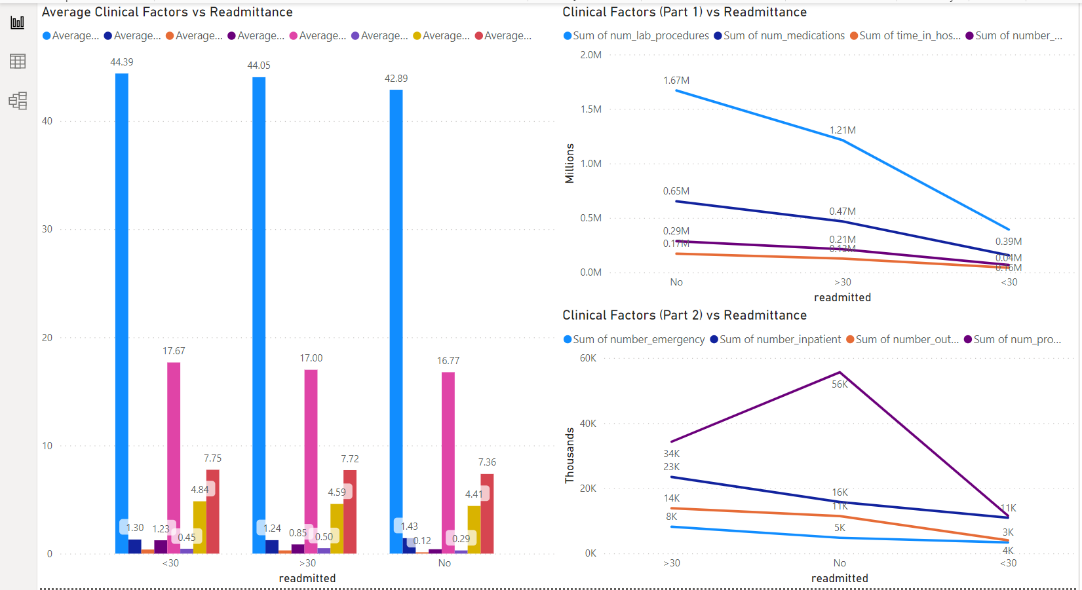
Clinical Factors that contribute to higher readmission rate
Notes:
What clinical factors contribute to higher readmission rates?
For diabetes patient
The bar chart compares the average number of lab procedures, medications, inpatient visits, and emergency visits for patients who were readmitted against those who were not.
There is a higher intensity of clinical services is associated with readmissions.
This graph shows the total sum of lab procedures and medications for patients who were readmitted and those who were not.
Description: A graph comparing the sum of emergency and inpatient visits, as well as the sum of procedures, against readmission status.
This graph reinforces the pattern that greater use of certain healthcare services is related to readmission.

Slide 8
Trends
Patients readmitted <30 days show higher clinical complexity with more lab procedures and medications.
A higher number of medications is associated with patients readmitted <30 days, indicating medication management as a risk factor.
High utilization of emergency, inpatient, and outpatient services correlates with higher readmission rates <30 days.
In particular, the number of inpatient visits is a prominent factor, with a sharp decline in counts for patients not re-admitted or readmitted >30 days
Notes:
Patients who are readmitted within 30 days demonstrate greater clinical complexity, indicated by increased numbers of lab procedures and medications. The data suggests that managing a higher number of medications is a significant risk factor for readmission within this timeframe. Additionally, frequent use of emergency, inpatient, and outpatient services is closely linked to readmissions occurring less than 30 days after discharge. Notably, inpatient visits stand out as a critical factor, with a marked decrease in frequency among patients who are not readmitted or those readmitted after more than 30 days.
Clinical factors such as lab tests, medication count, and healthcare service utilization are strong contributors to readmission risks.
Effective management of these clinical factors may reduce readmission rates, suggesting a focus area for healthcare providers.

Slide 9
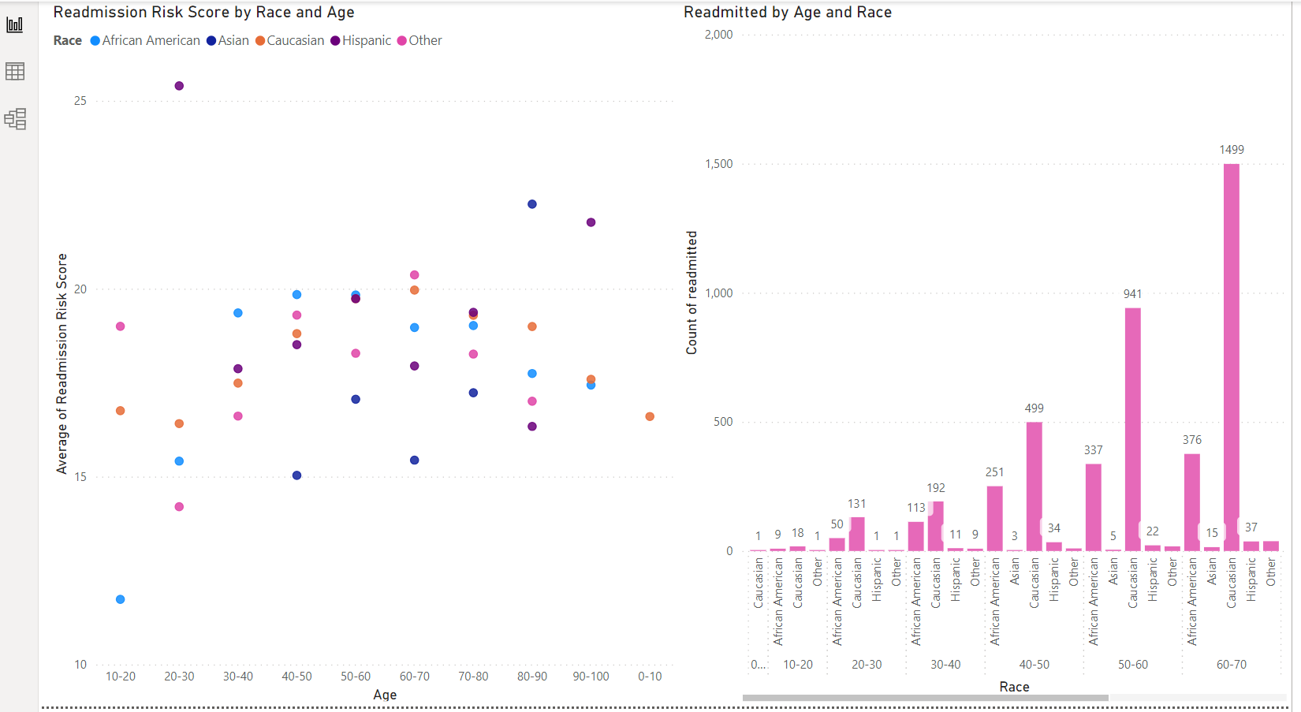
Disparities or Biases in Readmission Risk Predictions for different Demographic groups
Notes:
1. Are there any disparities or biases in readmission risk predictions for different demographic groups?
readmittance (<30) and diabetic patient
This scatter plot visualizes the average risk of hospital readmission for patients across different age groups, segmented by race.
Key Observations:
Data points are color-coded by race, indicating potential variations in readmission risk scores among different racial groups.This bar chart shows the actual count of patients who were readmitted, categorized by age and race.
This bar chart shows the actual count of patients who were readmitted, categorized by age and race.
Key Observations:
It is important to note that this does not factor in the proportion of each group in the overall population.
We have used readmission risk in our scatter plot which is a calculated field . We created using [num_medications] ,[time_in_hospital], [num_lab_procedures]

Slide 10
Trends
Risk scores for readmission vary across different age and racial groups.
African American patients tend to have higher readmission risk scores, particularly in middle age.
The count of readmitted patients is highest for African Americans, especially in the 50-60 age bracket.
Other racial groups show lower readmission counts, with the least being among Asian patients.
Notes:
The summary of the readmission data indicates that there are variations in readmission risk scores when analyzed by age and race. Specifically, African American patients are observed to have higher risk scores for readmission, with this trend being most pronounced in the middle-aged segment. Additionally, African Americans also exhibit the highest actual readmission rates, particularly within the 50-60 age group. In contrast, other racial groups experience lower readmission counts, with Asian patients having the fewest readmissions among the groups studied.
Data indicates potential racial disparities, with African Americans at a higher risk of readmission.
Age also plays a role, with middle-aged patients showing higher risk scores and readmission counts.
The lower readmission risk for Asian patients suggests potential differences in care or health status.
These disparities may require targeted interventions to ensure equitable healthcare outcomes.

Slide 11
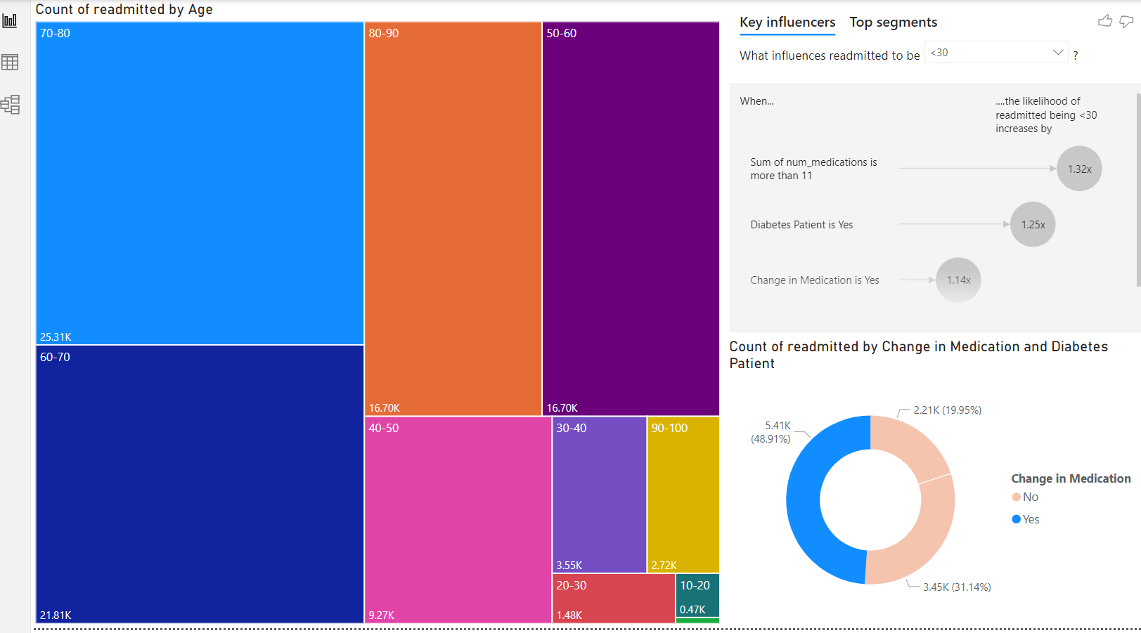
Interventions healthcare providers implement to reduce Readmission risk for high-risk patients
Notes:
1. What interventions can healthcare providers implement to reduce readmission risk for high-risk patients?
A treemap representing the count of readmitted patients across various age groups, with size indicating volume.
2nd graph - To identify factors that significantly influence the likelihood of patients being readmitted.
A donut chart showing the proportion of readmitted patients who are diabetes patients and have had a change in medication.

Slide 12
Trends
Prioritize interventions for the 70-80 age group, which has the highest readmission counts.
Implement medication management programs for patients with more than 11 medications, as this increases readmission risk.
Strengthen diabetes care and education, as being a diabetes patient increases readmission risk.
Monitor and support patients with recent medication changes to prevent complications leading to readmissions.
Notes:
To effectively reduce hospital readmissions, it's crucial to focus on the 70-80 age demographic, which exhibits the highest number of readmissions. Addressing the risks associated with polypharmacy is also key; patients on more than 11 medications should be enrolled in medication management programs to mitigate potential risks. Concurrently, enhancing diabetes management and patient education is essential due to the increased risk of readmission among diabetic patients. Lastly, close monitoring and support for patients who have undergone recent changes in medication can help in preventing complications that may lead to readmission.
Targeted age-group interventions can significantly impact readmission rates.
Medication complexity is a key risk factor; simplifying regimens could reduce readmissions.
Enhanced support for diabetes patients is crucial due to their increased risk.
Careful transition management for any medication changes can help minimize readmission risks.

Slide 13
THANK YOU

